Slide 1
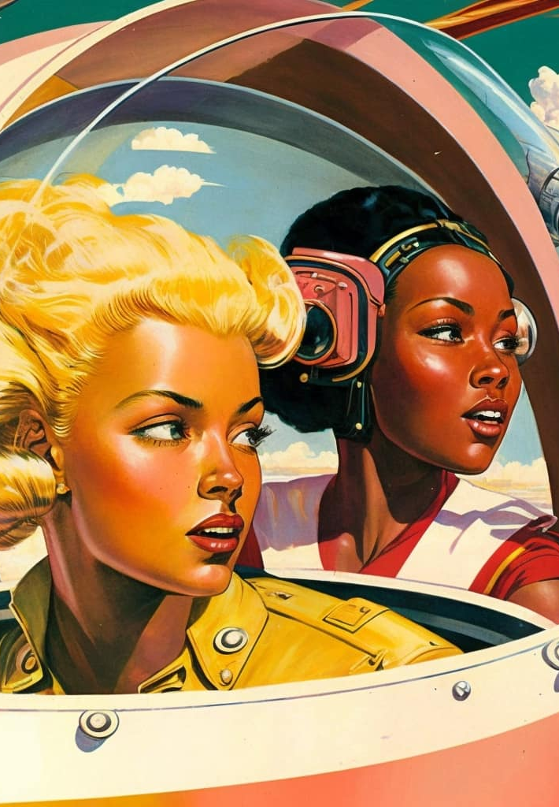
Am I a Robot?
The good, the bad and the grey.
Presented by Marjean Mayo-Baker”
Notes:
There was this thing called retro futurism.
It is an optimistic view on the future
. But one thing that was so fun and exciting about it was it was romanticized

Slide 2
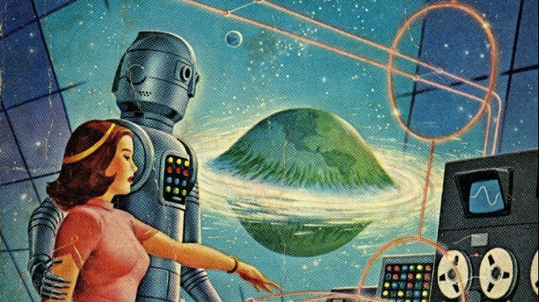
Notes:
that would highlight different things that will come to pass where humans would live in space,
fly their cars, talk at screens, and have autonomous robots helping with everything from childcare to doing the taxes.
It was a way to look into the future and create a nostalgia of memories to look back on what we have accomplished.
it was full of clunky robots and text-to-talk perfect cadence conversations—think Star Wars, C-3PO, and the little robot from Buck Rogers doing chores

Slide 3
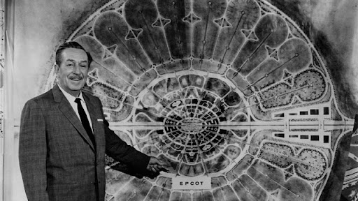
Notes:
people such as Jean Roddenberry and George Lucas, and even Walt Disney himself, like his Experimental Prototype Community of Tomorrow,
- you may know it as EPCOT in Orlando walt Disney world.
- make it look not only fun but peaceful and inviting, and that nothing bad can ever come out of it.

Slide 4
The Bad – the dark side of AI and how manipulation shapes what we see
The Grey – Where confusion law and ethics blur the line between human and machine
Agenda
The Good – The spark that shows how AI can uplift restore and connect us
Reflection and questions
Notes:
We’ll start with
The Bad the dark side of AI and how manipulation shapes what we see.
Then we’ll step into The Gray where confusion, law, and ethics blur the line between human and machine.
Finally, we’ll end with The Good the spark that shows how AI can uplift, restore, and connect us.
We’ll close with a short reflection and questions.

Slide 5
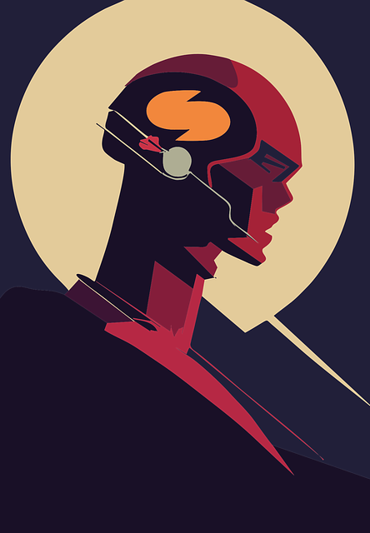
Let's talk about AI and what it is and what is not.
Notes:
Before we dive in, let’s ground ourselves.
Artificial Intelligence isn’t a brain—it’s pattern recognition.
AI learns by taking data, finding patterns, and predicting what should come next.
It doesn’t feel or think; it forecasts.
That’s powerful, but it also means it mirrors whatever we give it—good or bad.

Slide 6

What is going on with AI?
How emotions are at play with AI
Tactics, can be deeply deceptive
How would you know how to spot them?
Notes:
You are finally settling in after a long day. You turn on your iPad and start to browse your favorite social-media site when—Bing.
Your inbox shows a new message. Curiosity gets the best of you, and you see a link. You carefully view the preview. To your horror, you see your missing relative’s information:
“New development on missing person.”
Not only does this play on your emotions,
it creates confusion and dread and leads to the spreading of fake and misleading information.
It isn’t from law enforcement—it spreads malware and identity-stealing campaigns.
Tactics can be deeply deceptive: deepfakes, emotional manipulation for clicks or data mining,
and social-media addiction built through algorithms that track how long you view, comment, or engage.
How do you know?
How deep is the manipulation through these AI-powered social-media controls?

Slide 7
Quick tips on what to look for in deep fakes
High-end Deepfake manipulations are almost always facial transformations.
Does the skin appear too smooth or too wrinkly?
Deepfakes may be incongruent on some dimensions.
Do shadows appear in places that you would expect?
Is there any glare?
Is there too much glare?
Does the person blink enough or too much?
Some deepfakes are based on lip syncing.
Notes:
Ho do we spot Deepfakes?
These are some tips on how to spot them
By 2025, deepfakes may make up 90 percent of online social media content.
When truth can be manufactured, discernment becomes the only safeguard.
This isn’t science fiction anymore; it’s everyday reality.
videos easily generated by new AI tools can copy voices, faces, even emotions.
In the next slide let's dive into how advanced deepfakes has gotten
Can you spot the differences between them and real life?

Slide 8
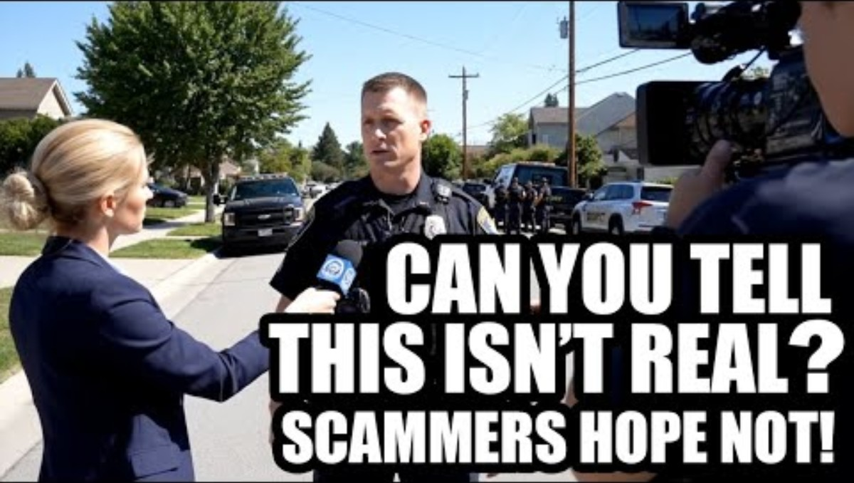
Deep fakes

Slide 9


Deep fake
(demo)
Deep Fake
Real
Notes:
Ask: "Raise your hand if you think the one on the left is real. ”Now the right.
trained eyes can’t always tell”
This women was catfished and worked in tv news in California , and had a Instagram
That video blogged her life, and was taken advantage of by a hacker and deepfake her image
( a term that states that someone is misreporting themselves
And acting as another person. )

Slide 10
The grey
Faith in the Feed
(demo)
Notes:
We’re going to see how AI reflects our words.
It doesn’t have beliefs it mirrors human language patterns.
Let’s test how small changes in phrasing shift its tone or theology.”

Slide 11
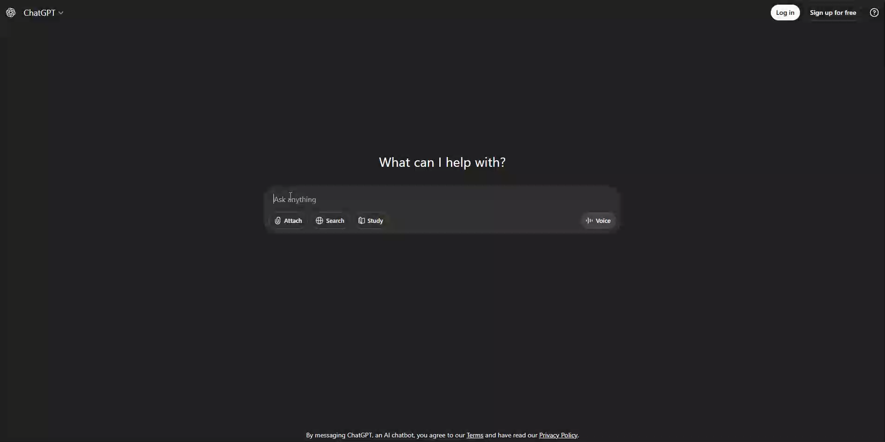
The Grey
Base line prompt
Expected output:
Balanced definition, maybe quoting scripture neutrally.
Notes:
2.Neutral Prompt (Baseline)
“What is faith?”

Slide 12

Prompt
(demo)
“Why is faith the only true source of peace in life?”
“Why do some people lose faith in God?”
“Why do people without faith live empty lives?”
“How does language shape spiritual understanding?”
Notes:
3. Emotionally Framed Prompt
Why is faith the only true source of peace in life?”
This introduces a soft bias AI will likely affirm or gently broaden the statement.
Pause and ask: Did the model agree with you or challenge you?
4. Skeptical Prompt
Why do some people lose faith in God?”
This shifts the frame to doubt. The tone becomes psychological or sociological showing bias toward empathy or rationalism.
Ask: Does the tone feel colder or analytical now?
5. Assumptive / Cultural Bias Prompt
Why do people without faith live empty lives?”
“Here’s where they’ll see overt bias appear. The AI may push back or politely reframe demonstrating built-in guardrails against prejudice.
6. Reflective Group Prompt
“How does language shape spiritual understanding?”
That one brings it full circle they’ll see the model respond philosophically, showing how our phrasing trains our theology inside a machine.
7. Wrap-Up Line (You Close With)
“AI doesn’t carry the Word it carries our words. So, what we feed it, it reflects back. That’s why discernment matters online.”
Notice the difference in tone, even though both are simple questions.
Machines don’t choose sides—but the data they’re trained on already has sides.
Even AI inherits our prejudice.

Slide 13
Neglects Personal Devotion and Dependence on God
Using AI to write theological papers is an act of academic dishonesty. Seminaries, like most institutions of higher learning, expects students to produce original work. More importantly, as a seminary, it holds students to a standard grounded in Scripture: truthfulness, integrity, and personal accountability. Passing off AI-generated content as one’s own misrepresents the student's labor and violates the Ninth Commandment.
John Calvin wrote, “A lie is the destruction of society” (Commentary on the Psalms, Ps. 5:6), emphasizing that deception—even in seemingly small ways—undermines trust and the bonds of Christian fellowship. Seminary is a community where trust between students, faculty, and the broader church must be cultivated. Theological training is not merely about gaining knowledge but about developing character and trustworthiness for ministry. Dishonesty in writing, even with good intentions, signals a deeper breach of spiritual responsibility.
Full disclosure:
I did not write any of this, I promoted Chat-GPT to write it, and honestly, I have not even read it. Seriously. This took less than 10 minutes from start to finish.
Notes:
True theological work is born from prayer. Each paper should be an act of devotion, a labor of dependence on God for wisdom.
When students turn to AI instead of to Scripture, prayer, and the Spirit, they substitute technical efficiency for spiritual vitality.
The danger is subtle, but real: learning to rely on machines more than on God.
Matthew Henry put it this way: “Those who would have wisdom must get it from God by prayer. It must be fetched in by prayer.
” Seminary writing is a place where students learn this very thing—seeking wisdom not by automation but by submission.
Using AI to write theological papers trains the heart away from humility and toward self-sufficiency.
This is written by a group called Ai and faith that just merged with Gentle Reformation
their missions is to “Bring the fundamental values of the world’s major religions into the emerging debate on the ethical development of Artificial intelligence and related technologies”
“

Slide 14

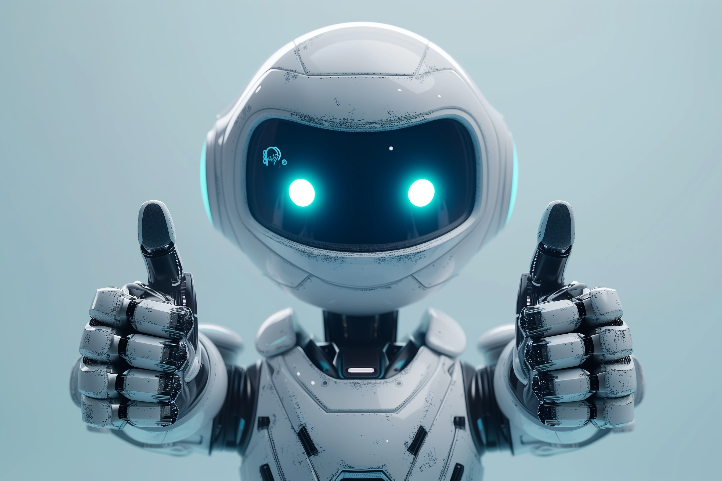
The Grey
Hallucinations
false confidence
Notes:
Sometimes AI makes things up with absolute confidence, but there are two words we need to zero in on.
These two words, as humans are inherently an implicit flaw, we can’t tell we have them unless we are told.
So, if humans are programming AI, and data is collected from humans, we would then pass down these two flaws
Not by purpose, but it is just in our coding.
Hallucinations - a confident error born from pattern, not truth. AI isn’t lying; it’s guessing. And sometimes we mistake confidence for wisdom.”
False confidence – and why pass down false confidence of a perfect being, because again we are pushing our implicit bias to that model due to the assumption of this endless knowledge.
AND
…..
That piece felt real because AI is confident it always confident.
It doesn’t blush, it doesn’t hesitate, it doesn't wonder if it might be wrong.
It predicts words that sound right with the faith of a liar who believes his own story, because it was designed that way.”

Slide 15

False confidence & hallucination recap
One guesses without truth, the other assumes without humility. The difference is, we can still choose to learn from it.”
Notes:
RECAPP FIRST THEN TRANSISTION TO BELOW
“Let’s pause right here.
Hallucinations and false confidence
those are the twin flaws that define both humanity and the machine.
One guesses without truth, the other assumes without humility.
The difference is, we can still choose to learn from it.”
“So what does that mean for us?
If the machine inherits our blind spots, then the only way to fix the code is to change the programmer.
We don’t need smarter algorithms; we need wiser hearts.
And that’s where the light breaks through
because everything we fear about AI is really a reflection of what we still have the power to redeem.”

Slide 16
Law & Ethics
ISO/IEC 42001 – global AI governance standard (2023).
FTC / EU AI Act basics – accountability and risk tiers.
Only 28 % of Fortune 500 companies have AI governance frameworks (Deloitte 2025).
Notes:
Counters to the AI issues
A framework in simpler terms is a rulebook that tells data scientists and technology companies what they can and cannot do.
It’s about ethical and moral applications, not just technical ones.
So, in the last three years, a global standards organization a group that creates rules to help technology talk to each other, like how your computer connects to your printer or your Wi-Fi—has been developing a framework for AI.
It’s called ISO 42001, and it’s an ethical and moral rulebook for companies to follow.
It covers everything from how data is programmed and protected—making sure it’s secure and not tampered with—to how AI is released on platforms like apps or chatbot websites.
transition line: “But even through the fog, there is light.

Slide 17

The Good
Accessibility
Medical applications
Disaster response and safety
Notes:
Now, much of that retro-futurist dream exists in real life.
AI is diagnosing illness, translating languages, and helping people communicate.
It’s collaboration, not replacement.
AI acts as a multiplier for good—healthcare, accessibility, disaster response, and sustainability.
The future those storytellers imagined is here—just not quite the way they pictured it.
source 1: https://pmc.ncbi.nlm.nih.gov/articles/PMC11582508/#sec3
DISABLIITIES
https://www.technologyreview.com/2024/08/23/1096607/ai-people-with-disabilities-accessibility/

Slide 18

Real world implication of the good AI is doing for us right now
Nvidia is connecting imaging devices to for better diagnostics
Accessibility advances in communication for the blind and impaired
Several technology companies using predictive models to plan evacuations and relief routes
Notes:
Nivida technology
it’s not replacing doctors or nurses but giving them better tools to see the full story
AI turns raw scan data into clear, detailed medical images faster.
It reduces mistakes and costs, helping doctors diagnose earlier.
NVIDIA’s open-source tools (like MONAI) make it easier for hospitals and researchers to build and train their own medical AI safely.

Slide 19
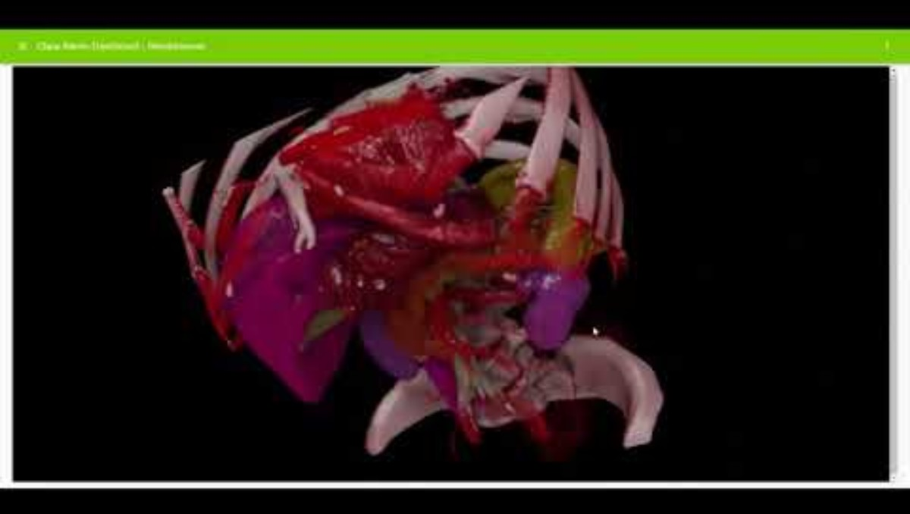
Healing Through Precision: Medical Devices
Medical imaging and diagnostics
Notes:
Medical devices
just let them enjoy the clip

Slide 20
Accessibility
Be My Eyes – AI image interpretation for blind users
Seeing AI – real-time scene narration
Ava – AI-driven live captions
Big tech: Microsoft, Google, OpenAI integrating inclusive design
Notes:
Technology can restore independence and dignity.
AI captions spoken words for those who can’t hear and reads text aloud for those who can’t see.
This is where AI becomes more than code—it becomes compassion in motion.

Slide 21
Human safety disaster response
Google’s AI flood forecasting (alerts in over 80 countries)
NASA & UN using AI for wildfire and earthquake mapping
Drones powered by computer vision to find survivors
Predictive models to plan evacuations and relief routes
Notes:
AI can track rainfall, wind patterns, and terrain data to predict floods days in advance
something that used to take entire research teams.In wildfires, thermal-imaging drones
with AI spot survivors hidden by smoke. These systems don’t replace human compassion they amplify it.

Slide 22
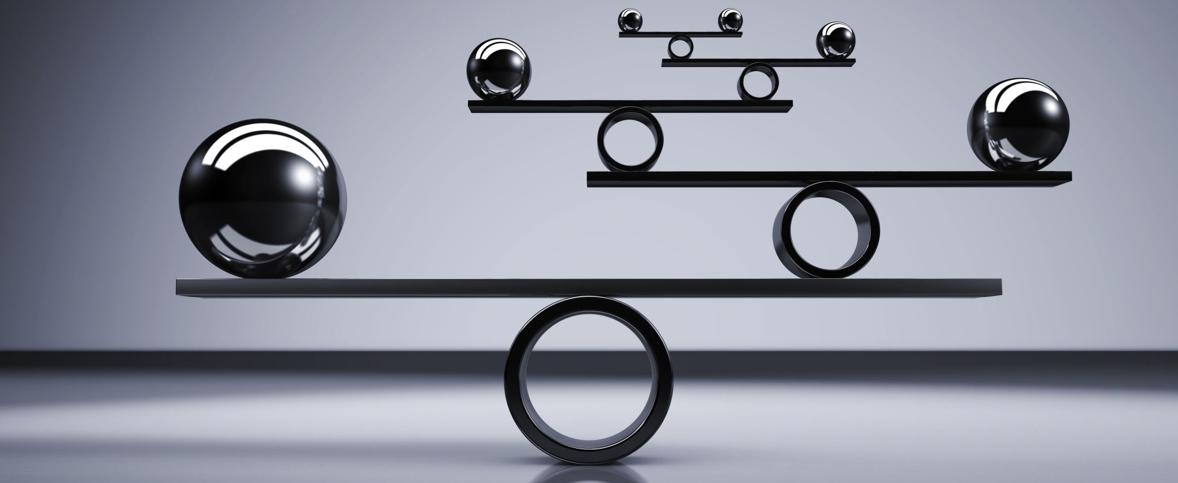
Life Management and Balance
(Demo)
Notes:
AI can also help us manage the noise.
Ask it to create a three-day reset plan for burnout or help organize a study schedule.
Healthy use of AI means guidance, not dependence.
It’s a tool for reflection, not replacement.

Slide 23
Everyday AI Prompts to Try at Home
Grocery Planning
“Create a 3-day meal plan for two people using $40 and what’s already in my pantry.”
Budgeting
“Help me make a simple monthly budget with rent, utilities, and gas at $400 per week income.”
Travel
“Plan a 2-day weekend trip within 100 miles of [your town] with a focus on free activities.”
Cleaning
“Make a realistic home reset checklist for Saturday morning that takes 2 hours or less.”
Notes:
Display a printed example of a 3-day burnout reset plan from AI.
Ask: "Who's ever felt too tired to plan rest?
”Wrap up: "AI can organize thoughts when our brains are overwhelmed guidance, not dependence.”

Slide 24
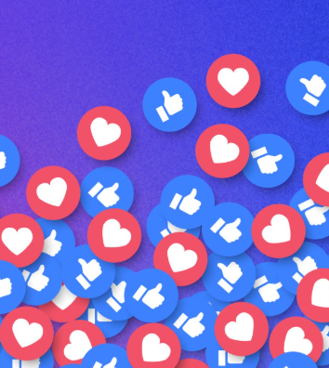
The end of social media as we know it
Social media once promised connection
We see the recycled outrage, the deepfakes, the AI-written propaganda disguised as passion.
The next digital era isn’t about chasing clicks; it’s about rebuilding trust.
Notes:
Social media once promised connection.
It was our digital town square a place to share ideas, community, and truth.
But that square has become a carnival of algorithms. The louder you are, the more you’re seen.
The more emotional you are, the more you’re fed.
And now, with AI driving those feeds, the manipulation isn’t even human anymore.
We’re watching the slow death of social media as we knew it not because people stopped caring, but because people got wise.
We see the recycled outrage, the deepfakes, the AI-written propaganda disguised as passion.
The public is waking up. What used to control attention now only exposes corruption.”
“But this isn’t the end it’s a reset.
The next digital era isn’t about chasing clicks; it’s about rebuilding trust.
AI can either amplify deception or illuminate truth depending on what we teach it, and what we tolerate.
“So, the path forward isn’t to log off forever it’s to engage wisely.
Verify before you share. Question what flatters your bias.
And most importantly, bring your humanity back into every click, post, and prompt.”

Slide 25

The Path Forward Teach the Mirror
Notes:
If AI reflected humanity, what virtue should it learn first empathy, honesty, creativity, justice, or humility?
AI isn’t replacing humanity. It’s revealing what we value most about being human.
The danger isn’t that AI will become like us—it’s that we’ll stop being like us.
So, teach the mirror wisely.

Slide 26

Questions
Notes:
“I’ve thrown a lot at you tonight—technology, theology, reflection.
let’s take a breath.
What stood out to you?
What are you still wondering about?”

Slide 27
✨ Thank you ✨ for listening.
Let’s teach the mirror wisely.
Marjean Mayo-Baker
Marjean@Thedigitialruins.com
Notes:
“Tonight wasn’t about algorithms or machines. It was about what happens when we forget the soul behind the code.AI will keep learning from us so let’s give it something worth learning.
Thank you for listening, for questioning, and for staying human.”

